Slide 1
Architecture Evolution
Presenter: Sudhakar Raju

Slide 2
Session 1 – Introduction to Modern Architectures
Topic | Subtopic | Objective | Duration
Architecture Evolution | Monolithic Architecture Client Server Architecture 3 Tier Architecture SOA Architecture | Participants understand various architectures, evolution and strength and weakness and relevance to current context | 30 mins
Modern Architectures | A) Micro Services Architecture Introduction to Micro services Challenges & Benefits Microservices Identification ( Domain Driven Design ) Sample Scoping Exercise Database Approaches Dedicated vs Shared Database Eventual Consistency vs Distributed Transactions Service Integration Overview - Service Bus/API Gateway/Service Mesh Event Driven Architecture | Introduce Microservices Architecture and discuss key aspects | 90 Mins
Modern Architectures | B) Front End Architecture Single Page Architecture & Micro Front ends Overview Discussion on Security, Performance, Caching etc. | Understand move from Server rendering of ASP. Net, JSP Pages, Ajax etc. to Component architectures such as AngularJS, React etc. | 30 Mins

Slide 3
Session 1 – Introduction to Modern Architectures
Topic | Subtopic | Objective | Duration
Modern Architectures | C) Cloud Native Architecture 12 Factor Apps Containers & Orchestration PaaS Overview Serverless Architecture Brief overview of other cloud native solutions like Storage Services, Event Hub, Streaming, API Gateway etc. | Able to understand Cloud Infrastructure and how it influences Application Architectures | 30 mins
Modern Architectures | D) Cloud Migration Approaches – Introduction | Introduce various migration paths for the apps – Retire, Refactor, Rewrite etc. | 30 Mins

Slide 4
Session 2 – Microservices Patterns
Topic | Subtopic | Objective | Duration
Microservices – Patterns | SAGA CQRS Event Sourcing Aggregator API Gateway Circuit Breaker | Common Design Patterns used in Microservices and their purpose | 90 mins
 | Decomposition Backend for Frontends Service Discovery Externalized Configuration Observability Security – OAuth, JWT |  | 90 Mins
Microservices – Patterns | Exercises - Use Cases Discussion |  | 30 Mins

Slide 5
Session 3 – Design Patterns & UML
Topic | Subtopic | Objective | Duration
Design Patterns - Introduction | Singleton Factory Builder Façade Proxy Adapter Composite Decorator Chain of responsibility Command Observer Visitor | Participants understand key patterns in Object/ Component Design | 90 mins
UML Introduction | Use Case Diagram Class Diagram Object Diagram Component Diagram Activity Diagram Deployment Diagram Others | Participants, understand and able to create UML diagrams with tools of their choice | 60 Mins

Slide 6
more complex, distributed….
Enterprise Architecture Evolution
Microservices
UX
SOA
UX
Svc
3-Tier
Service APIs
UX
2-Tier
Service APIs
Svc
Svc
UX
BL
Mono
BL
BL
UX
BL
Data
Svc
Svc
Svc
Software
Data
Data
Data
Data
Data
Data
Data
1970’s
1980’s
1990’s
2000’s
2010’s
Internet
Hardware
LAN
PC
Data Centers
Cloud
Servers
Virtualization
Mobile
Notes:
Journey of Enterprise Architecture. It started with monolith, then Tiered architectures – 2 tier, 3 tier came in. Till then the objective was to solve single purpose software.
Then came Service Oriented Architecture which was leap into way software are built. The term Enterprise Architecture truly made meaning when SOA was adopted.
SOA was all good for a while, when there was a need to simplify which introduced microservices
Remember, the software evolution was not in isolation, but was in rhythm the way hardware evolved from PC to servers to data centers and now the era of virtualization and cloud
While focus of this training is more towards modern architectures like Microservices, an understanding of other patterns, their strengths and weakness would help appreciate the newer architecture
Needless to say likelihood of developing any of the legacy architecture is very low, including the SOA

Slide 7
How do we evaluate an Architecture ?
Architecture
Characteristics
Availability
Reliability
Testability
Scalability
Deployability
Security
Agility
Fault Tolerance
Performance
…….

Slide 8
Monolithic Architecture
… formed of a single large block of stone.
… (of an organization or system) large, powerful, indivisible, and slow to change.
Built as single block of code, deployed in single box
Single Programming language
Single User Apps
No networking, communication across
Mono
UX
BL
Data
Examples:
COBOL, FoxPro, C, C++ Programs, Excel Apps
Notes:
Monolithic: The term refers to ”formed of single large block of stone”
In software terms, these are programs bundled as single package, having UX, Business Logic Data together.
And Build using single programming language

Slide 9
Monolithic Architecture
Least complexity
Ease of Development
Advantages
Mono
Scalability
Reusability
Maintainability
Disadvantages
UX
BL
Data
Notes:
Least Complexity: In current context, think of POCs

Slide 10
2-Tier Architecture
Client Application, deployed in user environment
Client
UX
BL
Enterprise
Server
Decoupled Database
DB
Example:
Windows Programs – VB, VC++, Oracle Forms etc.
Notes:
Tier is a reference when programs run in different process context
Layer is more organization of code in different , but run in single process space

Slide 11
2 Tier - Architecture
Easy to build
Sharing of data among users
Advantages
Deployment Challenges, Release management
PC Architecture
Operating System
Binary Shipping
Version Compatibility
Troubleshoot
Connectivity
Disadvantages
Change Management
Doesn’t this sound familiar to Mobile Development ?
Notes:
Relevance to Mobile Deployment
Next slide cue:
The challenges, along with advancement of networks, servers etc push folks to see how to minimize the client foot print

Slide 12
Client Application – Client Process or Virtual Machine or Web Browser
3-Tier (n-tier) Architecture
Client
UX
Enterprise
Heavy lifting done in server
Web/App/Component Server
BL*
Server
Decoupled Database
DB
Example:
Microsoft COM/DCOM, Java EJB, ASPX, JSP, Java Applets
Notes:
* Business Logic moved to server, there are variants in 3-tier or n-tier - Web Server, App Server

Slide 13
3 Tier - Architecture
Advantages
Scalable
Ease of Deployment
Web Client – Standardized client environment
Web Standardization
Disadvantages
B2B Interactions

Slide 14
Service Oriented Architecture
(SOA)
Client
UX
Service API – Contract between consumer and services
Enterprise
Web Server
Service APIs
HTML
JS
Images
App Server
BL
Database
DB

Slide 15
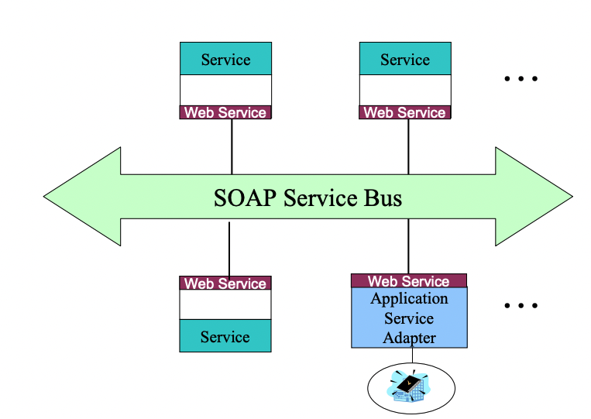
SOA Landscape
https://www.omg.org/news/meetings/workshops/MDA-SOA-WS_Manual/01-A1_Rosen.pdf

Slide 16
SOA Tenets
Tenet 1: Boundaries are Explicit
Tenet 2: Services Are Autonomous
Tenet 3: Services share schema and contract, not class
Tenet 4: Service compatibility Is based upon policy

Slide 17
The scope of SOA adoption can vary. Keep efforts manageable and within meaningful boundaries.
SOA can be realized through a variety of technologies and standards.
Establish a uniform set of enterprise standards and policies based on industry, de facto, and community standards.
Pursue uniformity on the outside while allowing diversity on the inside.
Evolve services and their organization in response to real use.
Separate the different aspects of a system that change at different rates.
Reduce implicit dependencies and publish all external dependencies to increase robustness and reduce the impact of change.
At every level of abstraction, organize each service around a cohesive and manageable unit of functionality.
http://www.soa-manifesto.org/SOA_Manifesto.pdf
SOA Manifesto ( Guidelines)

Slide 18
SOA Design Principles
Standardized Service Contract
Services adhere to a service-description. A service needs to have some information that defines what the service is about.
Loose Coupling
Services minimize dependencies on each other. So if the service functionality breaks at several points in time, this should not crush the client application or stop it from running.
Service Abstraction
Services wrap the logic they encapsulate from the unknown external world. The service shouldn't show how it performs its functionality.
Service Reusability
Logic is divided into services to maximize re-use.
Service Autonomy
Services must control the logic they encapsulate.
Service Statelessness
Services should stay stateless. This determines that services should not keep data from one state to the other. This would be required to be done from each client application.
Service Discoverability
Services can be discovered (usually in a service registry). We have previously viewed this in the theory of the UDDI, which performs a registry which can contain information about the web service.
Service Composability
It breaks large problems into tiny problems.
Service Interoperability
Services should use standards that provide different supporters to use the service.
https://www.xenonstack.com/insights/service-oriented-architecture

Slide 19
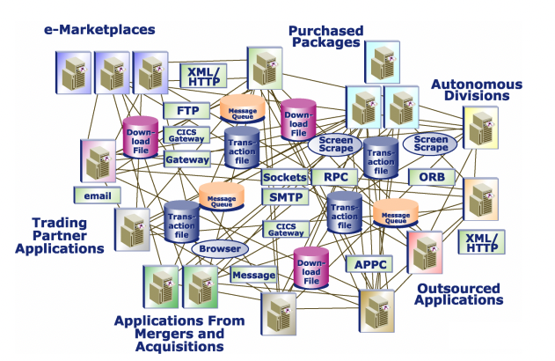
From enterprise Application “Sphaghetti”
https://www.omg.org/news/meetings/workshops/MDA-SOA-WS_Manual/01-A1_Rosen.pdf

Slide 20
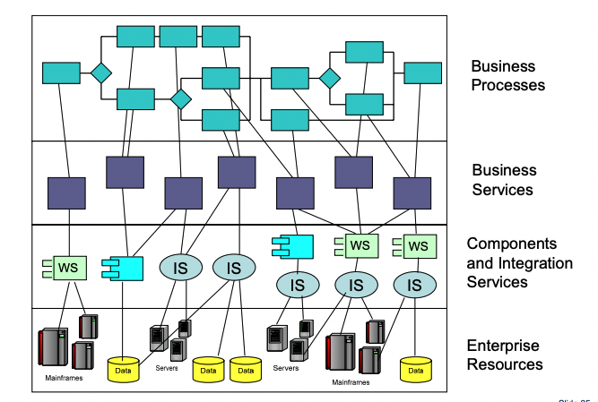
to SOA integration
https://www.omg.org/news/meetings/workshops/MDA-SOA-WS_Manual/01-A1_Rosen.pdf

Slide 21
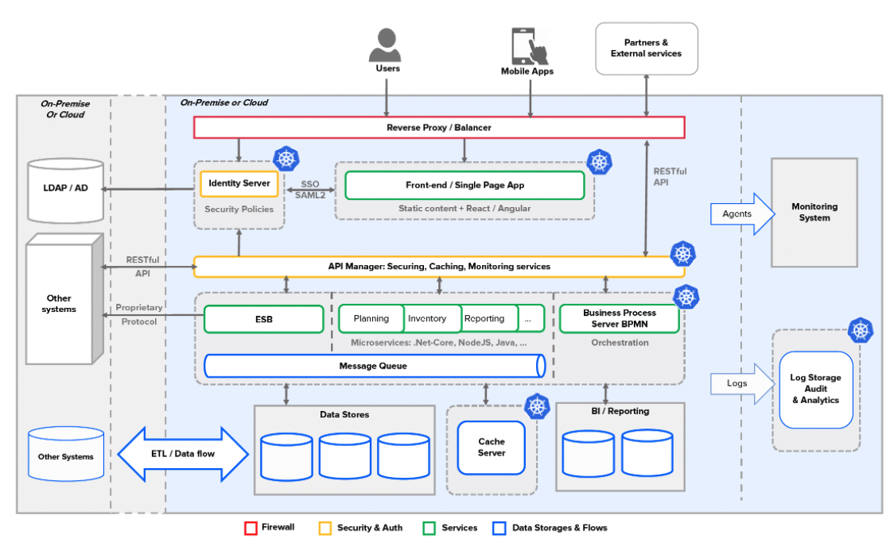
Travel Booking Enterprise Services – Technical Architecture
https://www.omg.org/news/meetings/workshops/MDA-SOA-WS_Manual/01-A1_Rosen.pdf

Slide 22
SOA – In Summary
SOA supports loose coupling everywhere in the project.
SOA supports interoperability.
SOA increases the quality of service
SOA supports vendor diversity.
SOA promotes discovery and federation.
SOA is location-transparent
SOA is still maturing and achievable idea
https://www.xenonstack.com/insights/service-oriented-architecture

Slide 23
SOA Advantages
Service Reusability: These applications are built from existing services. Thus, services can be re-used to create many other applications. ·
Platform Independent: The services are platform-independent as people can interact with separate applications over a common language. ·
Easy Maintenance: As services are independent of each other, they can be updated and transformed easily without harming other services. ·
Availability: These facilities are effortlessly available to anyone on demand. ·
Parallel Development: This architecture supports the layer-based design; it gives parallel development. ·
Reliability: These applications are extra secure because it is simple to test shortcode rather than large codes ·
Scalability: Services can work on various servers within an environment, this improves scalability
https://www.xenonstack.com/insights/service-oriented-architecture

Slide 24
SOA Disadvantages
SOA depends on the implementation of standards. Without standards, communication between applications requires a lot of time and code.
SOA is not for: applications with a high level of data transfer, applications that do not require the implementation of the request/response type, and applications that have a short life span.
Increasingly it becomes difficult and expensive to be able to comply with protocols and speak to service.
It implies knowing the business processes, classifying them, extracting the functions that are common to them, standardizing them, and forming with them layers of services that will be required by any business process.
https://www.xenonstack.com/insights/service-oriented-architecture

Slide 25
Appendix

Slide 26
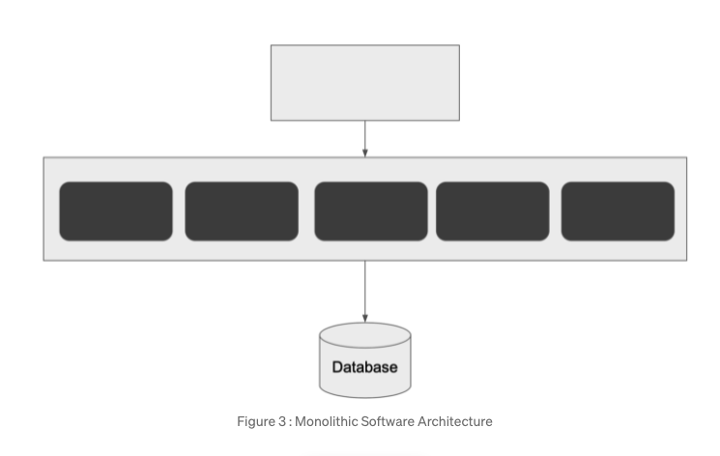
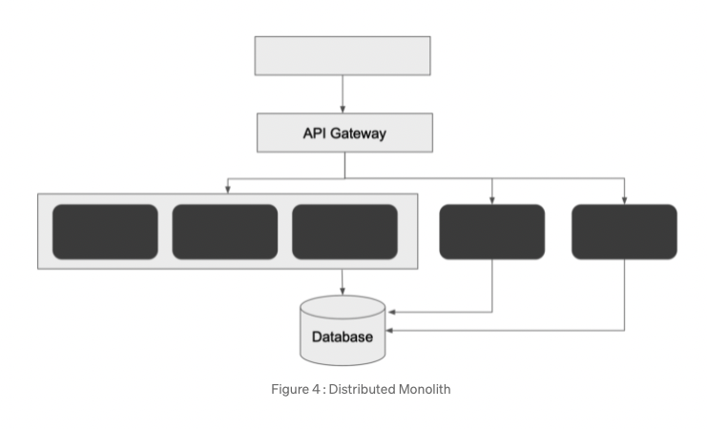
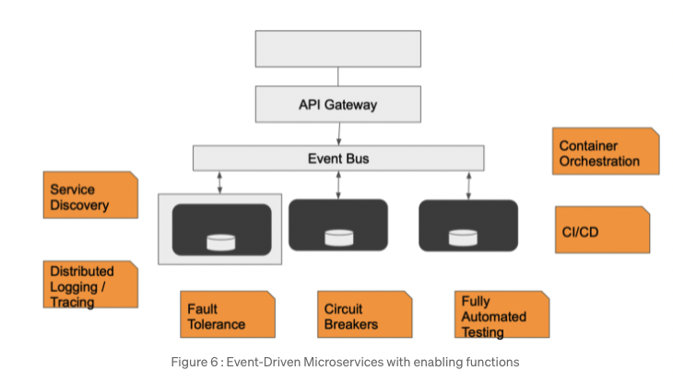

Slide 27
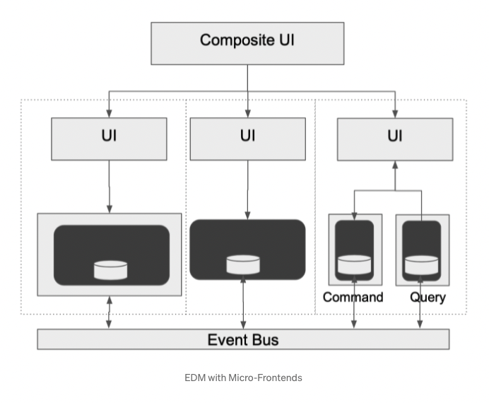

Slide 28
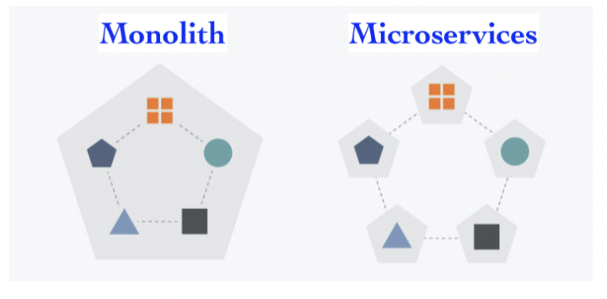
https://yessyp.medium.com/a-complete-understanding-of-microservices-53dc4e67cbc3

Slide 29
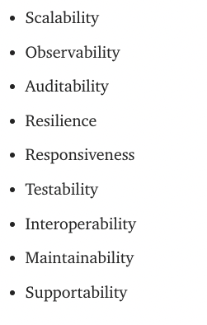
https://medium.com/@yt_13921/software-architecture-tradeoffs-series-part-1-599076b9bd5a

Slide 30
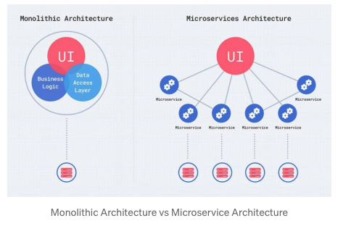

Slide 31
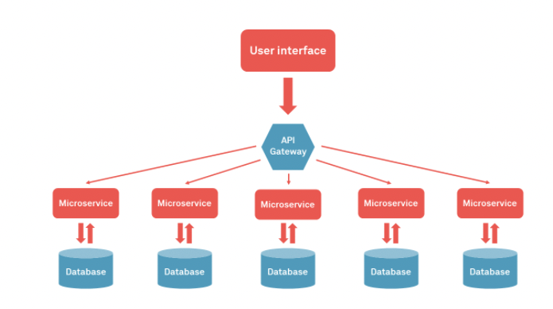
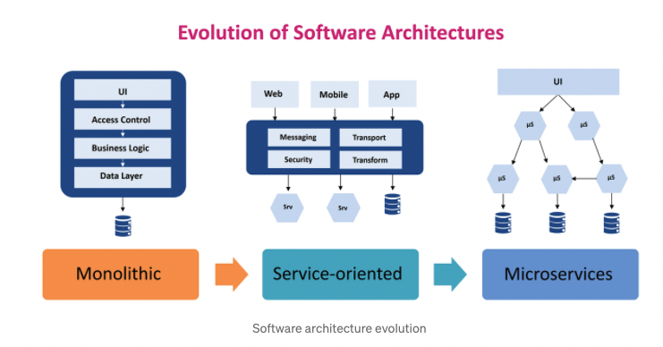
https://medium.com/techmonks/software-architecture-evolution-microservices-soa-monolith-d9264e0b986f

Slide 32
